Slide 1
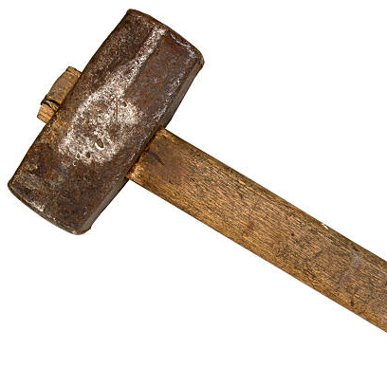
This talk
What entrepreneurship is
What entrepreneurship for good means (to me)
Why building matters when we talk about “good”
What mental models we can borrow from design when building for “good”
How those mental models are used in practice
Notes:
Welcome, everyone. Today I want to do five things together: define what entrepreneurship is, talk about what entrepreneurship for good means to me, make the case for why the act of building matters so much when we talk about “good,” borrow a few practical mental models from design, and then put those models to work in practice. Think of this as a builder’s guide to doing meaningful work—work that lasts and does right by customers, employees, and the community.

Slide 2
What is Entrepreneurship?
Notes:
[Slide 2: What is Entrepreneurship?]
Let’s start with a plain definition. I’m not talking about the movie version of entrepreneurship—I’m talking about what it actually does in the world.
In the next slide, I’ll use a classic line: entrepreneurship is shifting resources from low productivity to high productivity—reducing waste, increasing yield, creating new value.

Slide 3

Entrepreneurship, Broadly Speaking
“The entrepreneur shifts economic resources out of lower productivity and into higher productivity and yield.”
— Jean‑Baptiste Say (often cited via Peter Drucker)
Entrepreneurship = purposeful change that creates new economic/social potential.
Notes:
One of my favorite summaries comes via Jean‑Baptiste Say, often cited by Peter Drucker: the entrepreneur shifts resources from lower productivity to higher productivity and yield. In plain English: entrepreneurship is purposeful change that creates new economic or social potential. It’s the disciplined movement from “what is” to “what could be”—and that movement should produce real value people can feel.

Slide 4
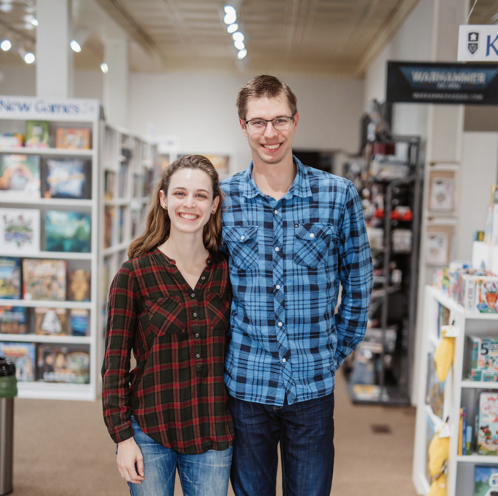
Entrepreneurship, Broken Down
Lifestyle Businesses
Social Entrepreneurship
Intrapreneurship
Scalable / Venture
Notes:
Entrepreneurship isn’t one monolith. You see it as lifestyle businesses, social ventures, intrapreneurship inside larger orgs, and the scalable, venture‑backed path. Different tempos, capital needs, and expectations—but the same core move: build something that truly works in the world.
[name check Paige and Xander]

Slide 5
Think about, and write down…
A business you engage with every day in each of these four categories
Or, your own business…
Write them all down and revisit them during this talk.
Notes:
Grab a quick mental list. What’s one business you touch every day in each of those categories? Or, if you’re building something now, use your own business. Write them down. We’ll keep coming back to them as our running case studies.

Slide 6

The thing they all have in common
Whether you’re building a lifestyle business or a scalable venture, you’re still building something live.
You’re still building something that shifts resources from low to high yield.
Notes:
No matter the path, you’re building something live—in public, with consequences. And the builder’s job is to move resources toward higher yield: more usefulness, more truth, more durability. That’s the heartbeat of the work.

Slide 7
What is Entrepreneurship for Good?
Notes:
So what makes it “for good”? I don’t mean halo‑polishing. I mean building in a way that creates value without pretending, without extracting, without leaving a mess for others to clean up.

Slide 8
Entrepreneurship for Good
Entrepreneurship ≠ business: it creates new economic and/or social potential.
That leverage cuts both ways: good or bad depends on the entrepreneur’s choices.
Startups feel consequences sooner: customers, employees, community.
Doing it right is ethical and operationally smart.
Notes:
So, this series is about business for good, but I think there’s a difference between business for good and entrepreneurship for good. The difference is that because entrepreneurs are creating new economic and/or social potential, their ability to effect change is tremendous. Whether that change is good or bad rests largely on the entrepreneur’s shoulders. The difference is also that entrepreneurs do not have the same scale to insulate themselves from their operational actions (you feel every loss customers, employees, and certainly the community more strongly), so getting this right is also good for business.

Slide 9
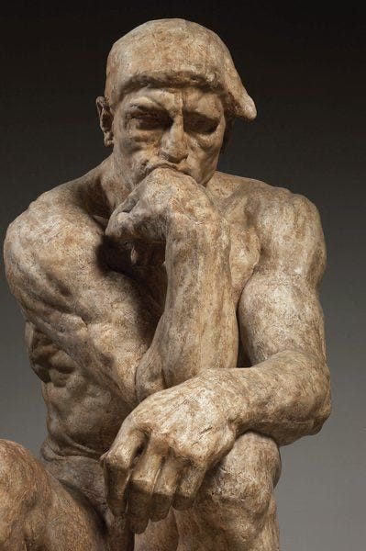
What is good?
I’m not defining “good” in the abstract.
Instead: use good design as a practical proxy for good business-building.
Good emerges by listening to reality’s constraints—not imposing a story on it.
Notes:
[Slide 9: What is good?]
I’m not going to answer that question. I’m not a priest. But I can tell you what good design looks like, and we can use that as a way to think about what good design of a business looks like, too. What is good emerges not from imposing our vision on reality, but by listening to reality and building something that aligns with it. That’s what design is all about. Imposing our vision leads to bad. Listening leads to good.

Slide 10

How do we know this?
Reality distortion ≠ ignoring reality.
When Jobs didn’t listen: Lisa + ouster at Apple.
Theranos: misrepresented capabilities → fraud.
Pattern: the story survives only if reality cooperates.
Notes:
We love the phrase “reality distortion field,” but it never meant “ignore reality.” Even Steve Jobs learned that the hard way with Lisa and his ouster from Apple. Theranos is the clearest cautionary tale: when you misrepresent capabilities, reality eventually answers—and it’s not kind. The story only survives when reality cooperates.

Slide 11
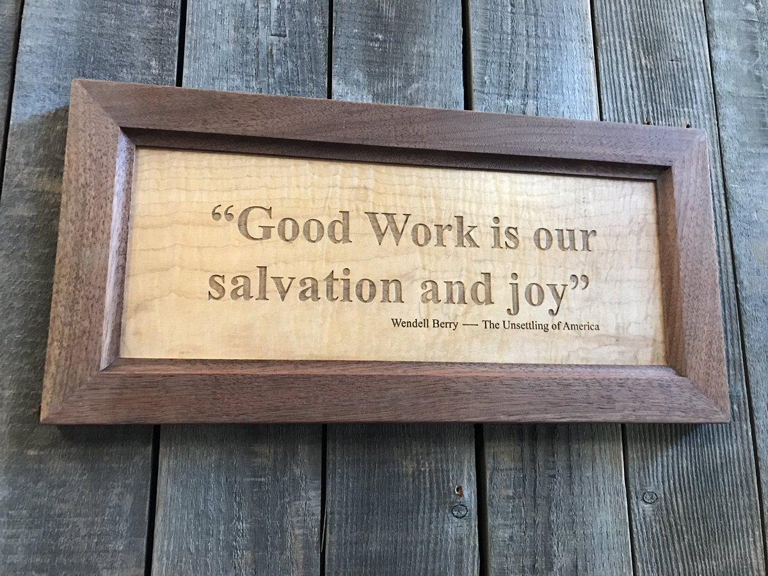
Wendell Berry sums it up best
Wendell Berry – philosopher, writer, thinker
“Good work is our salvation and our joy; shoddy or dishonest or self-serving work is our curse and our doom.”
Notes:
Wendell Berry puts it beautifully: “Good work is our salvation and our joy; shoddy or dishonest or self‑serving work is our curse and our doom.” As builders, we don’t get to escape that moral reality. Our work either reinforces the fabric around us—or it frays it.

Slide 12
Think about, and write down…
What are they transferring from low to high potential?
What are the potential impacts in doing so? Both positive and negative.
Notes:
Back to your four businesses. What are they moving from low to high potential? Be specific. And what are the likely impacts—good and bad—of making that shift? Train your eyes to see second‑ and third‑order effects, not just the headline outcome.

Slide 13
Why Building?
Notes:
Next: why building matters.
Entrepreneurship isn’t primarily a set of opinions. It’s an activity. And building is how you find out whether your ideas actually survive contact with reality.

Slide 14
Why Building?
Building is the entrepreneur’s core activity.
We build to run the business, and to understand the world around us.
Building is how we create value—by finding fit with reality.
Notes:
[Slide 14: Why Building?]
Building is what entrepreneurs do. It’s a key activity. It might sound silly, but: We need to build a business in order to run one. … and because building is a way of understanding the world around us (ourselves, others, and the environment). … so that we can create value.

Slide 15
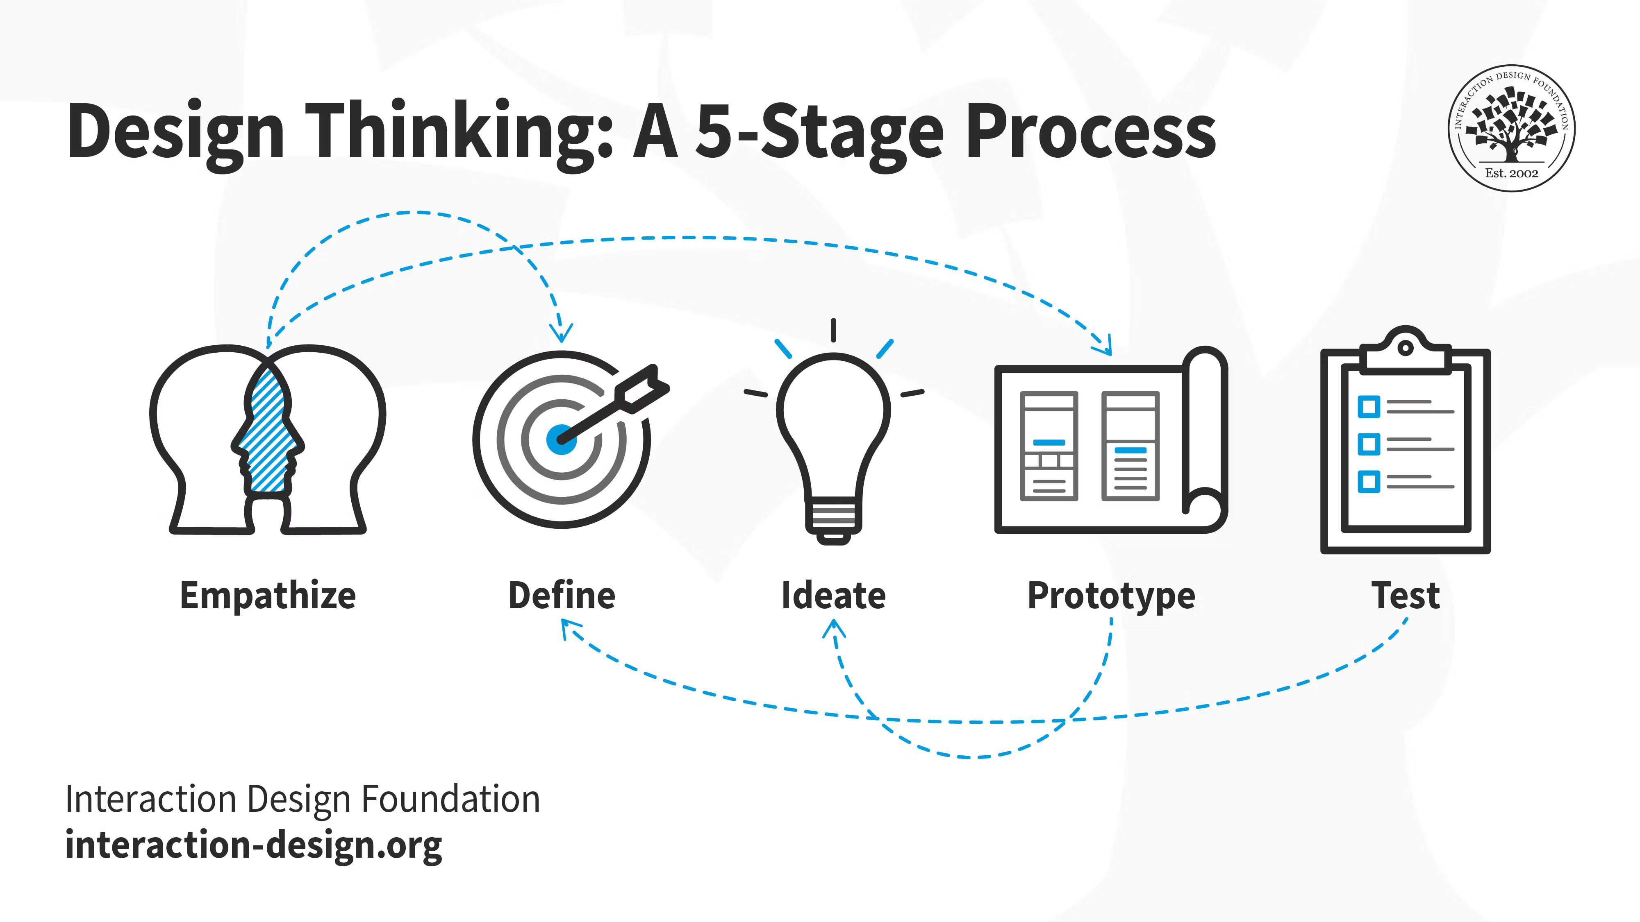
What’s the building process?
Notes:
Design Thinking gives us a practical method: empathize to understand, define to clarify, ideate to widen options, prototype to make ideas testable, and test to learn what reality will accept. It’s not a rigid checklist; it’s a way to keep moving while staying honest.

Slide 16
Design Thinking
The key here is that Design Thinking is methodological approach to building
We are looking for insight into how the world works by:
Understanding (empathizing)
Clarifying that understanding (defining)
Coming up with solutions (ideating)
Creating solutions (prototyping)
Seeing if they work (testing)
Notes:
The key here is that Design Thinking is methodological approach to building. We’re looking for insight into how the world works by: Understanding (empathizing) Clarifying that understanding (defining) Coming up with solutions that crystalize that understanding (ideating) Creating solutions (prototyping) And seeing if they work (testing)

Slide 17
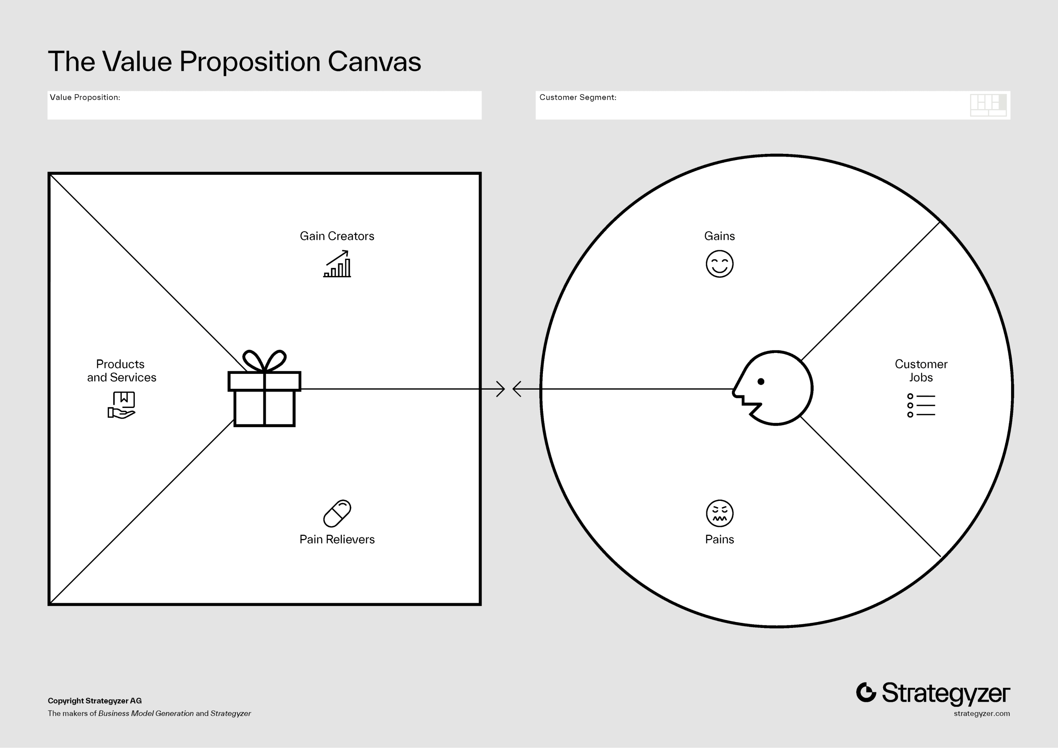
Applying DT to Business Building
We are applying a methodological approach that helps us understand what the world (reality) wants.
In doing so, we’re getting closer to product-market fit. This is extremely challenging.
Notes:
We’re applying a methodological approach that helps us understand what the world (reality) wants. In doing so, we’re getting closer to product-market fit. This is extremely challenging.

Slide 18
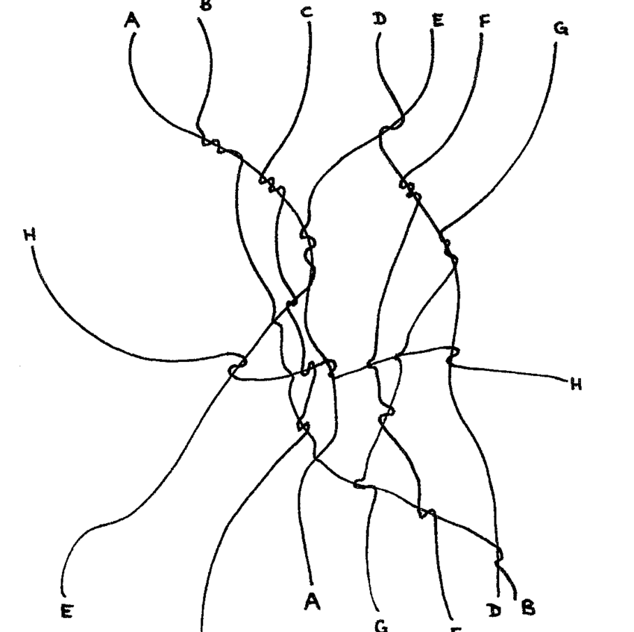
More on building
Building is how we find out what’s good.
Ethics emerge when materials and systems “talk back.”
Good = fit with constraints; bad = forcing a fantasy.
Notes:
Building is a way to find out what’s good. Ethics emerge from the process of building. We find out what reality wants, and what it rejects. Wood only wants to be cut with the grain. You can have an idea of what you want, but if the material doesn’t want to work that way, then the idea doesn’t matter. This applies to both products and businesses. What is good emerges from this conversation.

Slide 19
Think about, and write down…
Those four businesses you chose? Ask yourself: what is it that they listened to, and understood, about the world that makes them tick?
What is it that they’re doing that distracts or diminishes them? What aren’t they listening to?
Notes:
Return to your four businesses. What are they listening to and understanding about the world that makes them work? And where are they ignoring signals—distracting themselves or diminishing the value?

Slide 20
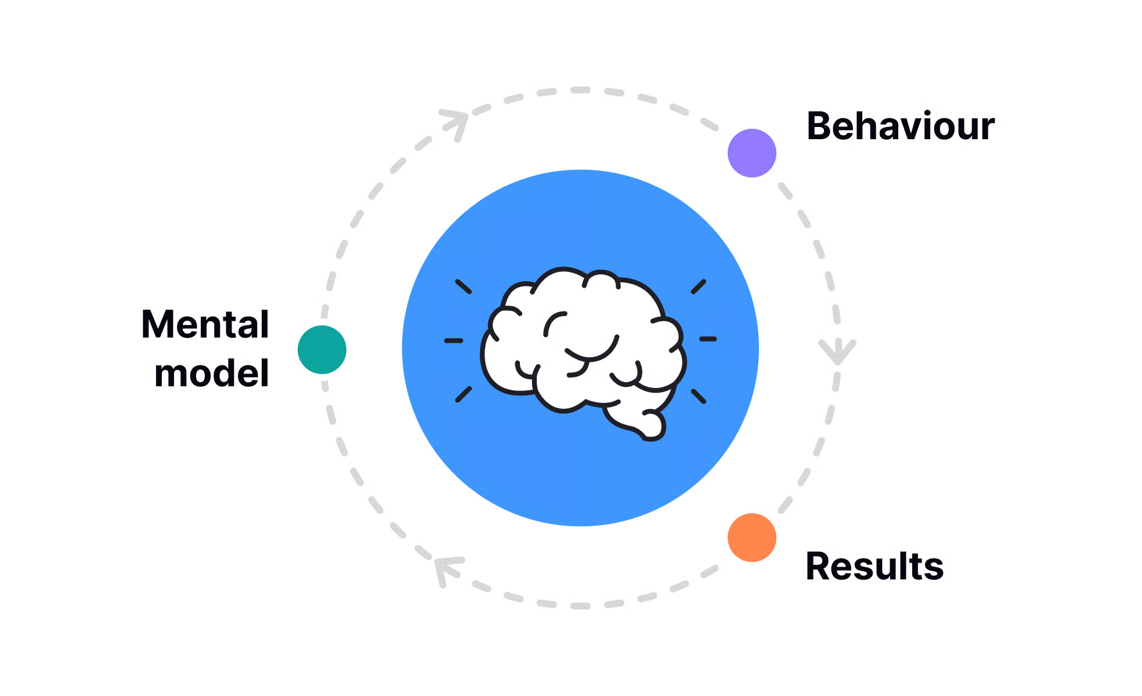
Mental Models
Notes:
[Slide 20: Mental Models]
At this point we have a method. The question is: how do we keep ourselves honest while we use it?
That’s where mental models come in—simple tests we can apply at every step to course-correct before we drift into nonsense.

Slide 21
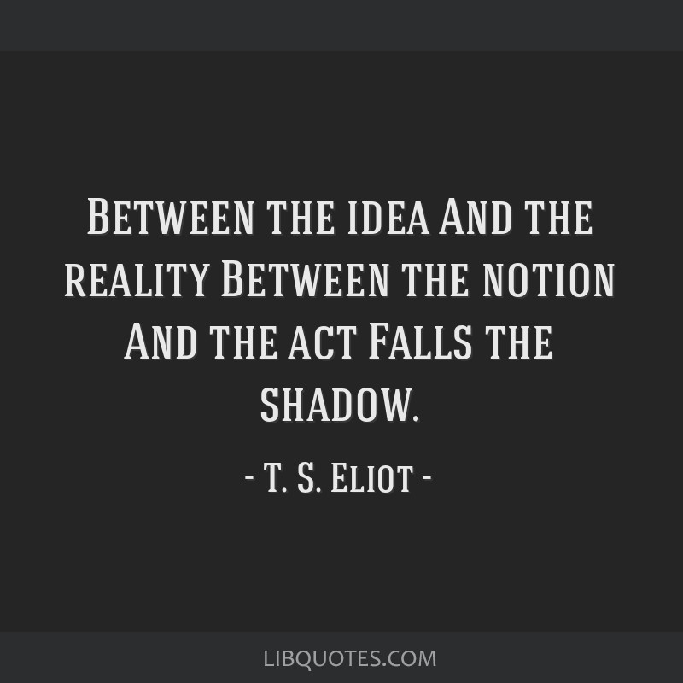
Mental Models
Mental models help us course-correct at every step of building.
They’re how we judge our work against what reality actually wants.
Notes:
The right model at the right time can save you months of drift. The trick is to keep them practical and to test them in the field, not only in our heads.

Slide 22

Dieter Rams
Famous designer, from Braun to Vitsoe
His stuff was so good that Jony Ive (Apple) lifted many of his designs during the iPhone era
10 principles of good design
Notes:
Enter Dieter Rams—whose influence you’ve felt in everything from Braun to Apple via Jony Ive. He articulated ten principles of good design that quietly shaped a generation of products.

Slide 23
10 Principles
Good design is innovative
Good design makes a product useful
Good design is aesthetic
Good design makes a product understandable
Good design is unobtrusive
Good design is honest
Good design is long-lasting
Good design is thorough down to the last detail
Good design is environmentally-friendly
Good design is as little design as possible
Notes:
Rams’ list is long—innovative, useful, aesthetic, understandable, unobtrusive, honest, long‑lasting, thorough, environmentally friendly, and minimal. We can translate these into something founders can use every day.

Slide 24
10 Principles, distilled
Purposeful Utility
Honest Restraint
Durable Care
Notes:
Here’s my distillation for builders: Purposeful Utility, Honest Restraint, and Durable Care. Useful, truthful, enduring.

Slide 25
Good Business Design is, therefore…
Good entrepreneurship creates something useful, that does not manipulate or oversell, and that can endure to stand the test of time.
Notes:
Put together: good entrepreneurship creates something truly useful, doesn’t manipulate or oversell, and can endure long enough to matter. That’s the bar.

Slide 26
Think about, and write down…
Those four businesses again. Do they follow all of our design principles? Where do they fail?
Purposeful Utility
Honest Restraint
Durable Care
Notes:
Check your four businesses against those principles. Where do they shine? Where do they cheat? If you had to fix one thing this month to better match the principles, what would it be?

Slide 27
Mental Models in Practice
Notes:
Now let’s take those mental models out of theory mode.
I’m going to compress them into a few practical tests you can actually use while you’re building—to judge work-in-progress, not just to critique from a distance.

Slide 28
Mental Models in Practice
Theory matters only if it survives practice.
In entrepreneurship, reality judges from three directions.
Notes:
We've covered method (design thinking) and principles (Rams). Now the claim is simple: theory only matters if it survives contact with reality. In entrepreneurship, "reality" isn't abstract - it shows up as feedback and consequences. And it comes from three directions: customers, employees, and the surrounding community. Those are the three judges we're about to use to audit our work.

Slide 29
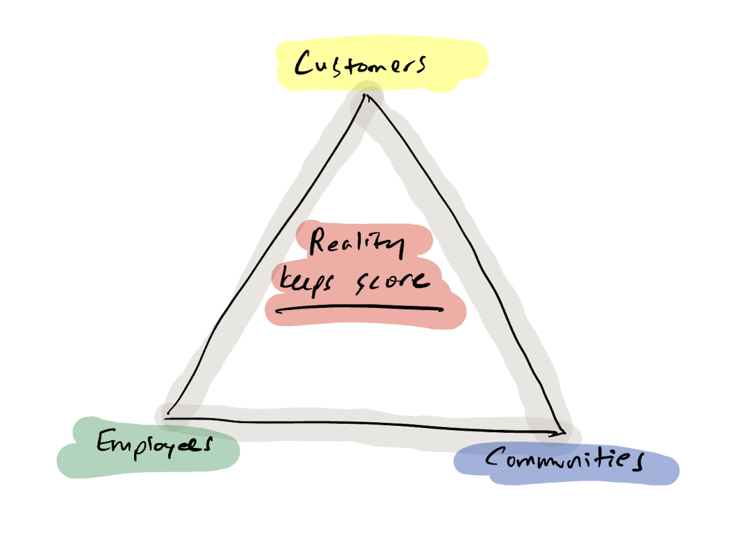
The Three Judges
Notes:
Here’s the core: three judges.
If you want entrepreneurship to be ‘for good,’ you don’t get to grade yourself. The judges are external: customers, employees, and the community. If you fail one of them, it shows up eventually—in churn, burnout, backlash, or collapse.

Slide 30
Purposeful Utility - Customers
Demand: real usefulness (not narrative substitution).
Signals: solves a recurrent problem; value is legible; minimal persuasion.
Tests: usage persists when marketing pauses; users can explain value plainly.
Failure smell: attention gets mistaken for value.
Notes:
First judge: customers. "Purposeful Utility" means you owe people real usefulness - something that actually works in their day-to-day, not a narrative that substitutes for function. When it's good, the value is legible: a specific recurring problem gets solved, and the feedback loop is short and acted on. Operational tests: if you disappeared tomorrow, would customers rebuild a workaround? Does usage persist when marketing pauses? The failure pattern is confusing attention for value.

Slide 31
Durable Care - Employees
Demand: systems that enable good work repeatedly without self-destruction.
Signals: clear roles; sustainable pace; quality > speed theater.
Tests: the org can breathe (vacations, handoffs, documentation).
Failure smell: heroics replace process; burnout becomes “commitment.”
Notes:
Our second judge: employees. "Durable Care" is about designing the operating system of the company so people can do good work repeatedly without self-destruction. In practice, that means clear roles, matching authority to responsibility, a sustainable pace, and documentation that makes handoffs possible. Test it: can someone take a week off without collapse, and do mistakes lead to system improvements? The failure pattern is predictable: heroics replace process and burnout becomes a badge.

Slide 32
Honest Restraint - Community
Demand: truthful participation without externalized harm.
Signals: claims match reality; growth respects local constraints.
Tests: who pays when things go wrong? would you want 10× more of this nearby?
Failure smell: privatized gains, socialized costs.
Notes:
Finally, our third judge: the community. "Honest Restraint" means your participation is truthful and you don't externalize harm. Claims have to match reality - especially impact claims - and growth has to respect local constraints: labor, housing, attention, waste, and noise. Test it: who pays when things go wrong, and would you want ten more businesses like this nearby? The failure pattern is privatizing gains and socializing costs.

Slide 33
Again with the four businesses, I know…
How do they succeed with the three judges?
Where do they fall short?
Notes:
Run your four examples through the three judges. Where are they strong? Where are they borrowing from the future or community without paying it back?

Slide 34

Bad Examples
Notes:
Let’s learn from some public flameouts—not to gloat, but to see the pattern.

Slide 35

Theranos
Failure mode: Narrative substitution.
Customers: promised function that didn’t exist.
Employees: secrecy/silos suppressed the work.
Community: medical risk externalized; trust damaged.
Notes:
Theranos is narrative substitution: the story replaced the working product. Customers were promised diagnostic usefulness that did not exist, so the "product" became secrecy and demos. Inside, employees were siloed and concerns were suppressed to protect the narrative. The community cost was medical risk externalized onto patients, and trust in diagnostics damaged.

Slide 36
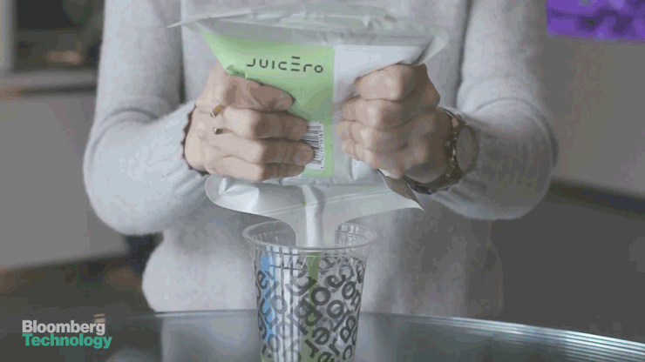
Juicero
Failure mode: Overdesign without use.
Customers: no meaningful improvement over manual alternatives.
Employees: optimized for spectacle, not outcomes.
Community: capital/material waste dressed as innovation.
Notes:
[Juicero is overdesign without use. The machine was elaborate, but it didn't deliver a meaningful improvement over simple manual alternatives, and reality punctured the value proposition. Internally, effort optimized for spectacle rather than necessity. The community story is waste: capital and materials burned for marginal benefit, wrapped in innovation language.

Slide 37

FTX
Failure mode: Scale without constraint.
Customers: funds not safeguarded; risk hidden behind trust.
Employees: no controls; personality-driven operations.
Community: systemic damage; losses socialized.
Notes:
FTX is scale without constraint. Customers believed funds were safeguarded, but trust substituted for verifiable controls and risks were hidden. Internally, controls were absent or ignored, so chaos became normal and got rebranded as "moving fast." The community impact was systemic: inflated confidence, broad losses, and long-tail reputational damage.

Slide 38
A Pattern, Not Three Accidents
Theranos: replaced function with story
Juicero: replaced usefulness with spectacle
FTX: replaced restraint with scale
Bad entrepreneurship doesn’t fail randomly. It fails predictably—when reality is ignored.
Notes:
Theranos: replaced function with story Juicero: replaced usefulness with spectacle FTX: replaced restraint with scale Bad entrepreneurship doesn’t fail randomly. It fails predictably—when reality is ignored.

Slide 39
Good Examples
Notes:
Now let’s look at the other side: quiet winners that earn endurance.

Slide 40

Basecamp
Success mode: Deliberate constraint.
Customers: narrow, recurrent problem; legible value.
Employees: sustainable pace; writing-first clarity.
Community: candid tradeoffs; avoids hype cycles.
Notes:
Basecamp is a counterexample: deliberate constraint. Customer value is narrow and legible - team coordination without cognitive overload - and features are added only when they reduce friction. For employees, the system protects people by default: sustainable pace, clear boundaries, and a writing-first culture that reduces ambiguity. For the community, Basecamp avoids hype cycles and is candid about tradeoffs and limits.

Slide 41

Iron Galaxy
Success mode: Craft before scale.
Customers: reliability—ports, maintenance, delivery.
Employees: mentorship + continuity (careers, not churn).
Community: stabilizing local force in a volatile industry.
Notes:
Iron Galaxy is "craft before scale." Their customer value is doing the hard, unglamorous work others abandon: reliable ports, maintenance, and shipping stable games. Internally, that requires continuity - mentorship, shared craft knowledge, and avoiding boom-bust cycles. Their reputation is built on delivery, not posturing.

Slide 42
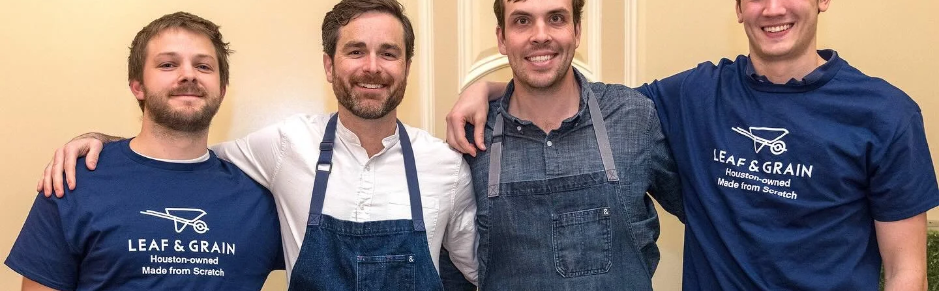
Leaf & Grain
Success mode: Place-specific fit.
Customers: consistent, accessible healthy food.
Employees: predictable systems in a punishing industry.
Community: careful scaling; strengthens neighborhoods.
Notes:
Leaf & Grain is place-specific fit. Customer value is everyday and repeatable: accessible healthy food where consistency matters more than novelty. Internally, humane predictability is designed into operations; standards and training reduce firefighting. In the community, growth is careful and anchored so the business strengthens its surroundings rather than hollowing them out.
[name check Deets]

Slide 43
What “Good” Looks Like in Practice
Basecamp: limits growth to protect usefulness
Iron Galaxy: values durability over spectacle
Leaf & Grain: fits its place instead of overpowering it
Good entrepreneurship doesn’t chase scale. It earns endurance.
Notes:
Basecamp: limits growth to protect usefulness Iron Galaxy: values durability over spectacle Leaf & Grain: fits its place instead of overpowering it Good entrepreneurship doesn’t chase scale. It earns endurance.

Slide 44

At W&L
Building means putting yourself into the work.
Honor and integrity can be designed into the business.
Teaching people to build this way scales impact.
Notes:
Building business means putting yourself into it If we believe the values of W&L are important (as I do), then we are building businesses that have honor and integrity By teaching people to build businesses with these principles, they imbue them with honor and integrity. We have the power to effect greater change

Slide 45
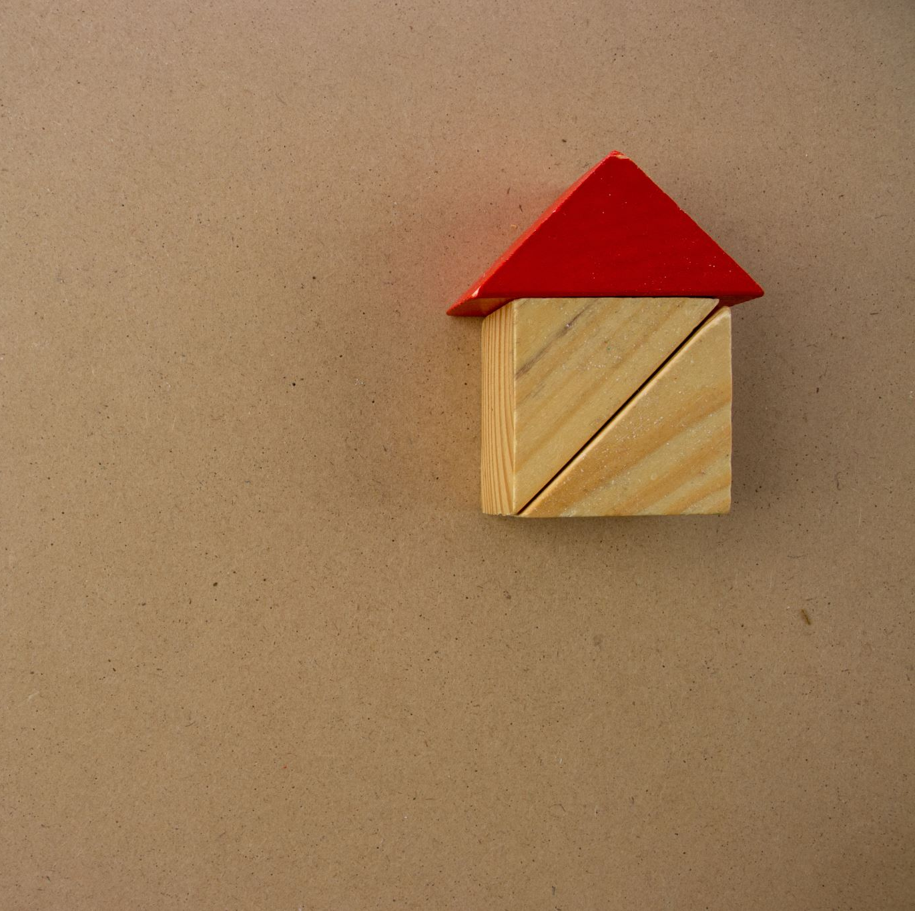
At W&L
Learning to build
Learning to build well
And learning to do all of this by building
Notes:
We focus on learning to build, learning to build well, and learning by building. Reality is the best teacher.

Slide 46
Conclusion
Notes:
Alright—let me land this.
I’m going to restate the throughline in a few sentences: what entrepreneurship is, what ‘for good’ means in practice, and what it looks like to build with taste.

Slide 47

Entrepreneurs Build
Entrepreneurs make businesses
Businesses make offerings
And there’s no better time to build than now.
Notes:
Entrepreneurs make businesses Businesses make offerings And there’s no better time to build than now.

Slide 48
Good Entrepreneurs Build with Taste
Now that we can build almost anything…
…the question becomes: should we?
Mental models + the three judges help answer that.
Notes:
Now that it’s possible that we can build almost anything, the question isn’t can I build this, but should I build this? That’s where the mental models come into play That’s where the three judges come into play.

Slide 49

Good Taste is Good Business
Find what we should build → satisfies design principles.
Satisfy design principles → satisfies the three judges.
Satisfy the three judges → earns endurance (and profit).
Notes:
Once we find out what we should build, we’re satisfying the principles of design. Once we satisfy the principles of design, we satisfy the three judges. Once we satisfy the three judges, we profit.

Slide 50
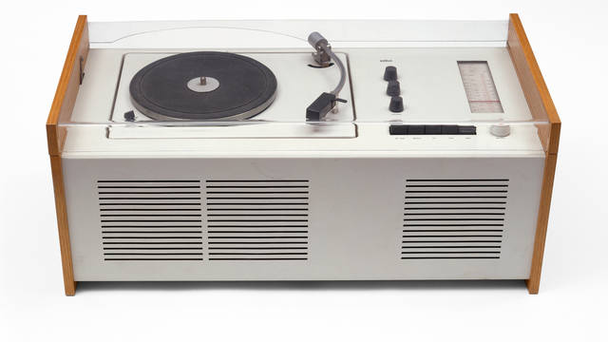
Good Business is Good for Everyone
We create value for the customer
We create jobs for employees
We create economic opportunity for the community
Notes:
Good entrepreneurship is a rising tide: value for customers, good jobs for employees, and opportunity for the community.

Slide 51
Thank You
Notes:
That’s the talk.
Thank you for the time and attention. I’m happy to take questions, push on edge cases, or talk about how you’d apply these tests to a business you’re building right now.

Slide 52
What you can do next
Ways to engage with entrepreneurship at W&L
Entrepreneurship Summit at W&L, March 20-21
Sign up to mentor a student team
Speak at a class
Become a class judge
Entrepreneur In Residence Program
Notes:
Join us at the W&L Entrepreneurship Summit, March 20–21. Mentor a student team, guest‑speak in a class, judge a pitch, or serve as an Entrepreneur‑in‑Residence. Your craft matters.

Slide 53
Resources
If you want to go deeper, here are a few places to start.
Peter Drucker on entrepreneurship and purposeful change
Dieter Rams’ principles (and good writing about ‘taste’)
Design thinking basics: empathize → define → ideate → prototype → test
Wendell Berry on good work
Notes:
[Slide 54: Resources]
If you want to go deeper, here are a few places to start.
• Peter Drucker on entrepreneurship and purposeful change
• Dieter Rams’ principles (and good writing about ‘taste’)
• Design thinking basics: empathize → define → ideate → prototype → test
• Wendell Berry on good work
And if you want a curated list for this specific talk, I can send it.

